Slide 1
Peer Observations of teaching during covid-19
Matthew Paolucci Callahan, PhD
Center for Teaching and Educational Technology Sonoma State University

Slide 2
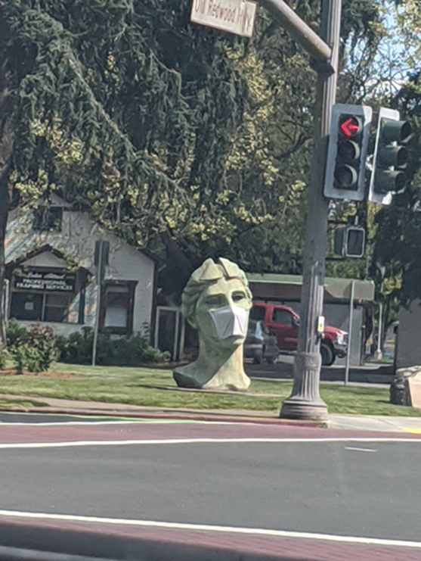
Effect of Covid-19 on Teaching
Complete, rapid overhaul from in-person to online instruction
This means essentially brand-new preps for all of us
Large class sizes make online teaching more difficult
Six months of shelter in place, homeschooling, etc has taken a toll on all of us.
New faculty in particular face tough challenges

Slide 3
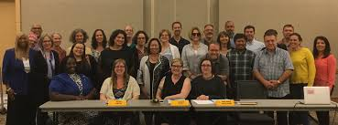
Resolution Regarding Evaluation of Teaching Performance and RTP Review During the COVID-19 Emergency (04/16/20)
“RTP reviews of probationary faculty impacted by the COVID-19 crisis be conducted with sensitivity to the difficulties those faculty experienced during the crisis and with as much flexibility as is possible.”
“That the SSU Academic Senate urge that a copy of this resolution be placed in every faculty member’s Personnel Action File (PAF) to provide the context for understanding the circumstances surrounding the periods including Spring 2020, Summer 2020, and potentially Fall 2020, and their potential impact on RTP processes and outcomes”

Slide 4
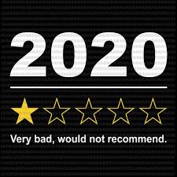
Recommendations for Peer Observations this Year
Take the context and circumstances into consideration
Provide context (“Dr. X completely redesigned her course for online instruction.”)
Highlight and praise professional development efforts.

Slide 5
Sources of Evidence for Teaching Effectiveness
1. The self-assessment
2. Peer observations
3. SETE’s
4. Open-ended student feedback
5. Assessment/outcomes efforts
6. Scholarship of teaching and learning
7. Teaching-focused professional development *
Professional development is an important source of evidence for teaching effectiveness

Slide 6
Examples of Professional Development
Summer institute
CTET workshops
Independent study
Consultations with CTET faculty peers and/or faculty fellow

Slide 7
Remote peer observations(?)
Question: “How do we conduct peer observations of classes that do not meet in person? Some teach synchronously but many do not. Does CTET have guidelines for peer observations of online teaching?”
Answer: the criteria for evaluating teaching have not changed, and policies should be the guide. But observations can broaden beyond the class session

Slide 8
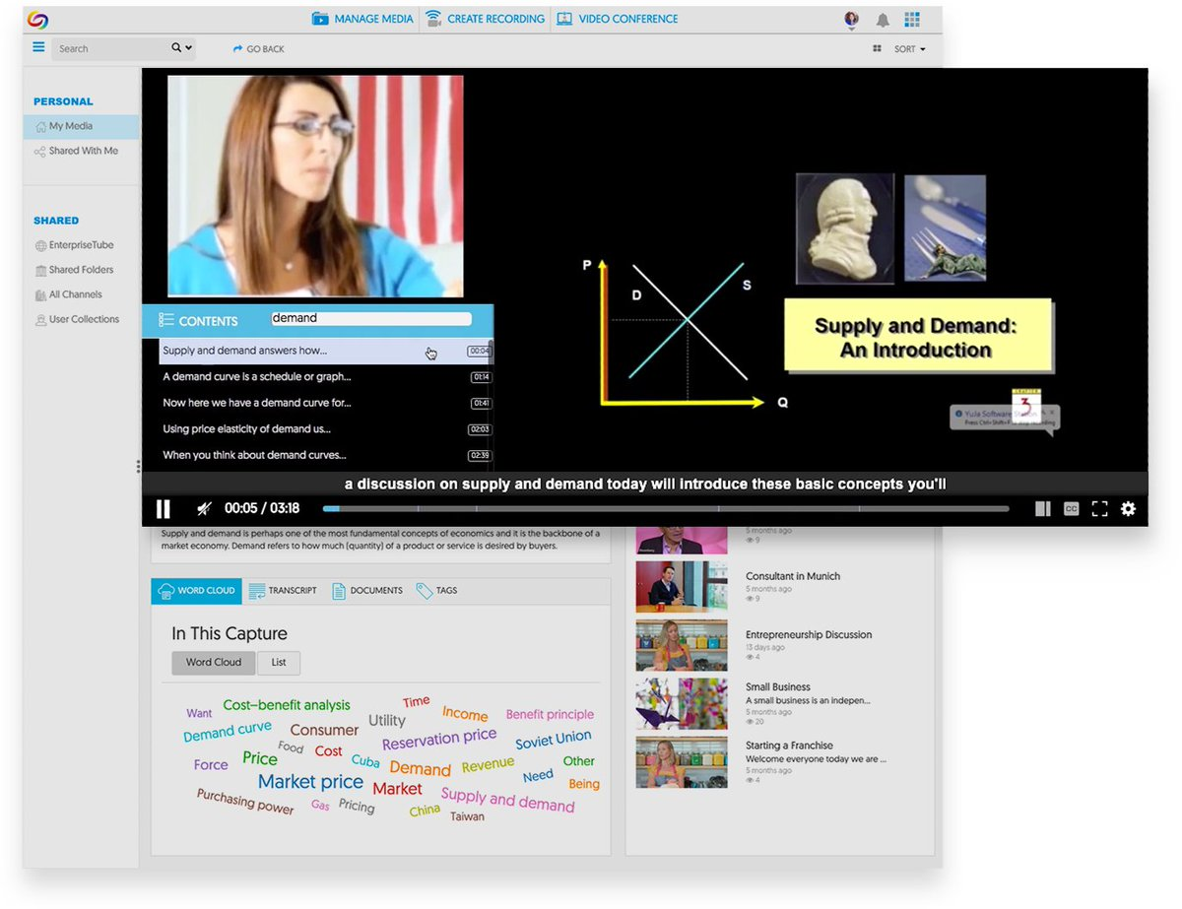
Broaden Scope of Observation
1. Course design/syllabus
2. How learning is measured
tests, projects, labs, exams
3. Observing a remote class session or instructional videos

Slide 9
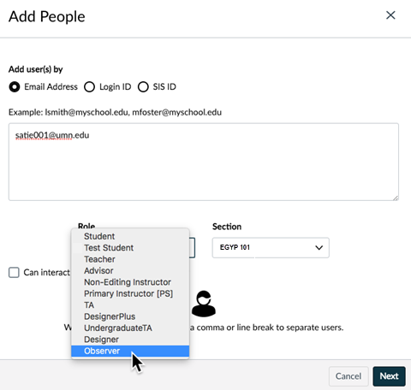
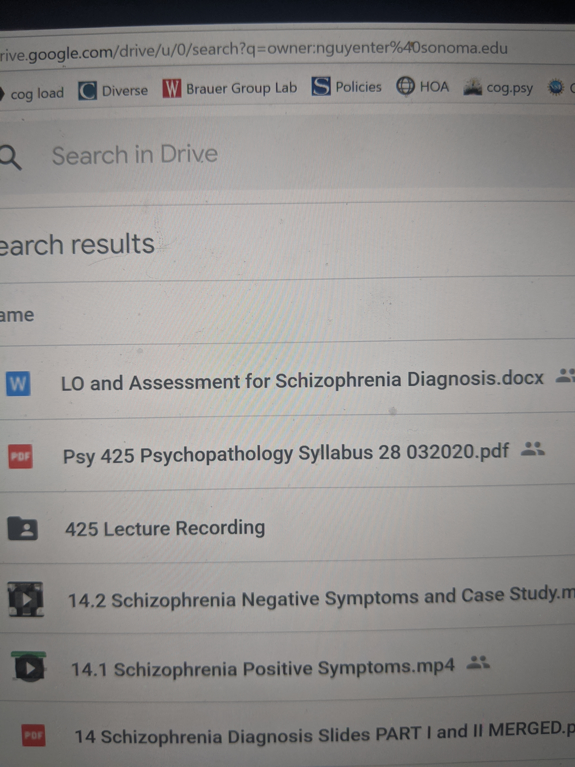
Options for Sharing Course Materials
1. Add as an “Observer” in Canvas, but specify which module/materials to focus on for the class session.
2. Google drive or Dropbox

Slide 10
1. Syllabus and Course Design

Slide 11
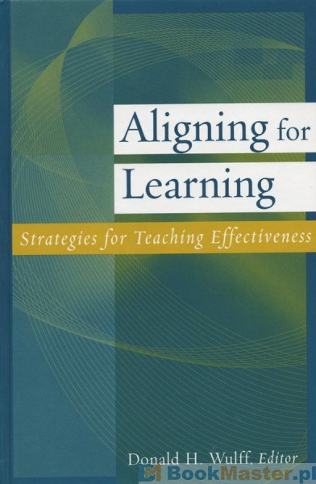
Hallmarks of excellent syllabi
Organized: Course schedule, content and due dates
Evaluation and expectations are crystal clear
Learning is not over or under assessed
Tone of syllabus engages (versus discourages) the learner
Highly recommend this book

Slide 12
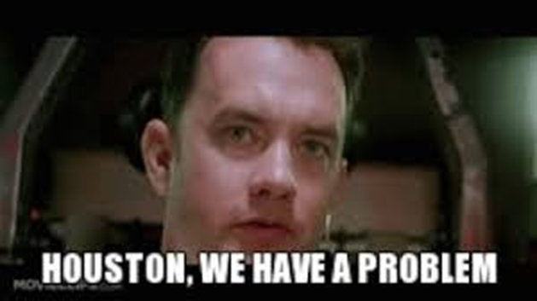
Reviewing a Syllabus
Areas of concern
Content problems
Evaluation not clear
No/vague schedule
Unreasonable policies
Punitive tone
Areas for growth
Over or under assessment
Content suggestions
But consider the context.

Slide 13
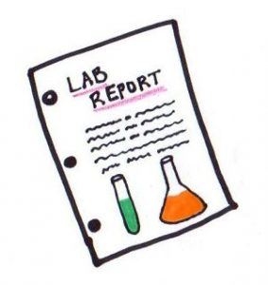
2. Measures of student learning

Slide 14
Hallmarks of effective measures of learning
Tests/exams/assignments/labs
Frequent and lower stakes
Clear, well-written items
Aligned with primary points taught

Slide 15
Reviewing measures of learning
Areas of concern
Lack of clarity
Lack of criteria
Very poorly written items
Areas for growth
Professional development on effective testing
Clearer/better rubrics
Ways to deepen/tweak measure
But again, consider the context!

Slide 16
3. Observing remote “class sessions”
Synchronous Courses
Observe a zoom session
A limited number of classes meet in person
Asynchronous Courses
View prepared videos (Yuja, Camtasia, Zoom)

Slide 17
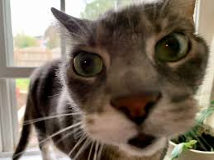
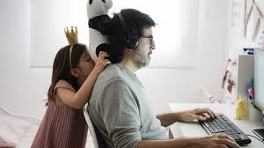
Suggestions for observing remotely
Focus on –
Content clarity
Pace/amount of material
Avoid critiques of –
Management of the zoom session
Video glitches (these do not need to be perfectly edited and “production ready”!)
And again, remember the context.

Slide 18
Peer Observations of teaching during covid-19
Matthew Paolucci Callahan, PhD
Center for Teaching and Educational Technology Sonoma State University

